Slide 1
PROPAGATION & REFLECTION OF PLANE WAVES
10.0 PROPAGATION & REFLECTION OF PLANE WAVES
10.1 ELECTRIC AND MAGNETIC FIELDS FOR PLANE WAVE
10.2 PLANE WAVE IN LOSSY DIELECTRICS – IMPERFECT DIELECTRICS
10.3 PLANE WAVE IN LOSSLESS (PERFECT) DIELECTRICS
10.4 PLANE WAVE IN FREE SPACE
10.5 PLANE WAVE IN CONDUCTORS
10.6 POWER AND THE POYNTING VECTOR

Slide 2
10.0 PROPAGATION & REFLECTION OF PLANE WAVES
Will discuss the effect of propagation of EM wave in four medium : Free space ; Lossy dielectric ; Lossless dielectric (perfect dielectric) and Conducting media.
Also will be discussed the phenomena of reflections at interface between different media.
Ex : EM wave is radio wave, TV signal, radar radiation and optical wave in optical fiber.
Three basics characteristics of EM wave :
travel at high velocity
- travel following EM wave characteristics
- travel outward from the source
These propagation phenomena for a type traveling wave called plane wave can be explained or derived by Maxwell’s equations.

Slide 3
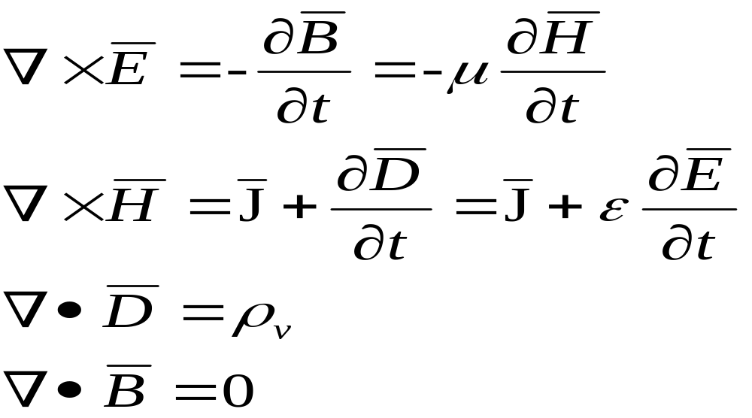
10.1 ELECTRIC AND MAGNETIC FIELDS FOR PLANE WAVE
From Maxwell’s equations :

Slide 4
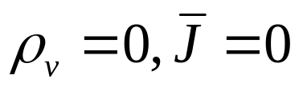
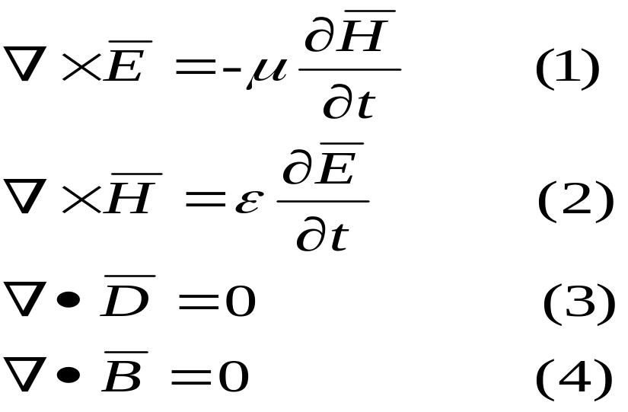
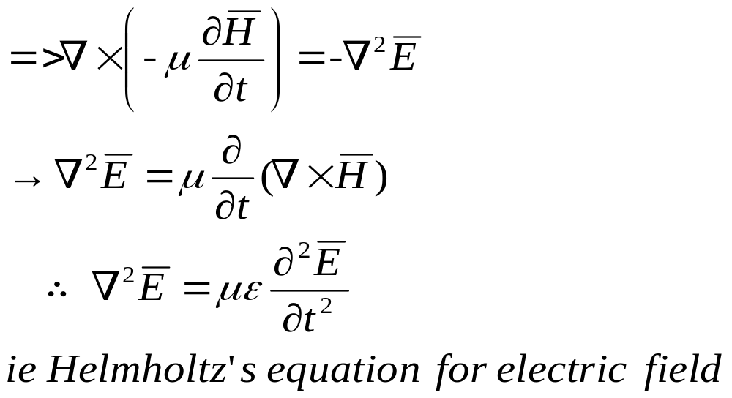


Assume the medium is free of charge :
From vector identity and taking the curl of (1)and substituting (1) and (2)

Slide 5
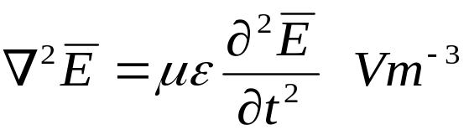
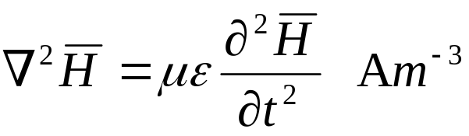
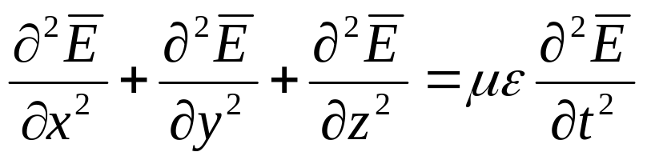
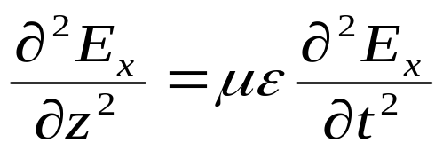
Similarly in the same way, from vector identity and taking the curl of (2)and substituting (1) and (2)
In Cartesian coordinates :
Assume that :
Electric field only has x component
Propagate in the z direction

Slide 6
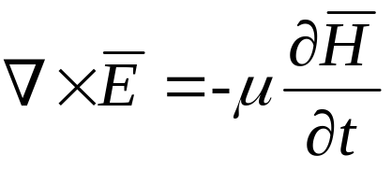
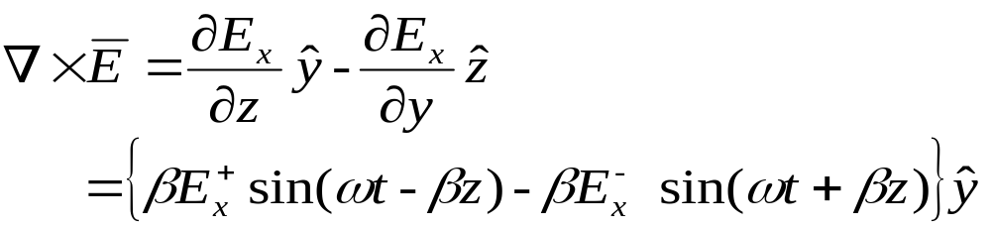
The solution for this equation :
Incidence wave propagate in +z direction
Reflected wave propagate in -z direction
To find H field :

Slide 7
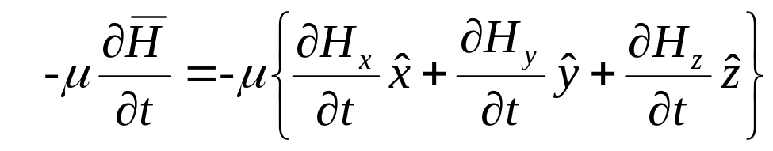
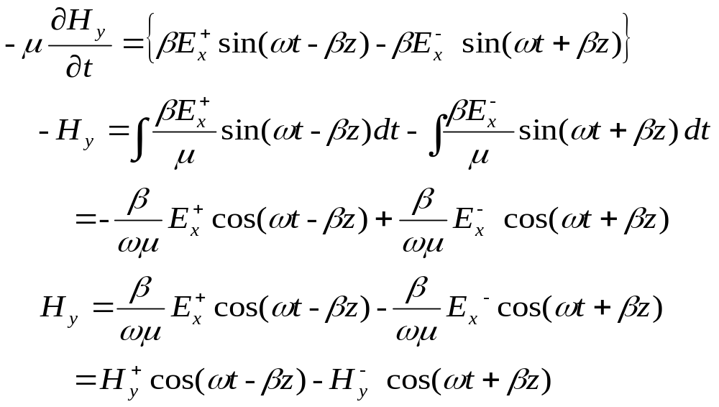
On the right side equation :
Equating components on both side = y component

Slide 8

Hence :
These equations of EM wave are called PLANE WAVE.
Main characteristics of EM wave :
Electric field and magnetic field always perpendicular.
NO electric or magnetic fields component in the direction of propagation.
will provides information on the direction of propagation.

Slide 9
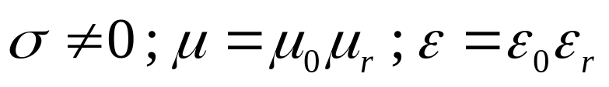
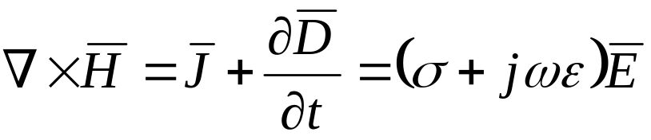
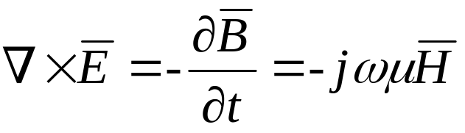
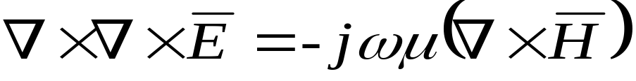
10.2 PLANE WAVE IN LOSSY DIELECTRICS – IMPERFECT DIELECTRICS
Assume a media is charged free , ρ_{v} =0
(1)
(2)
Taking the curl of (2) :

Slide 10
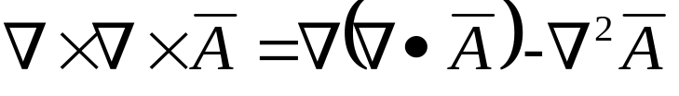
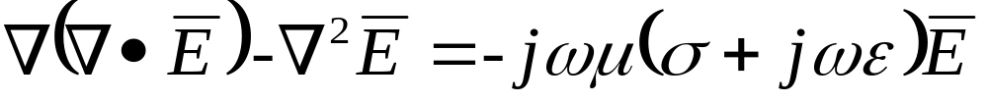
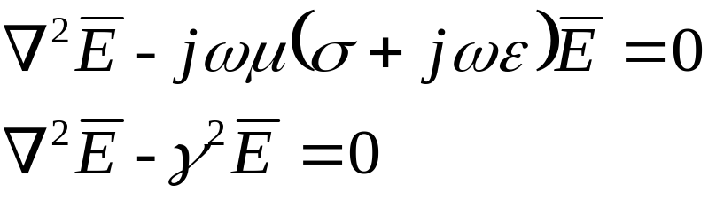
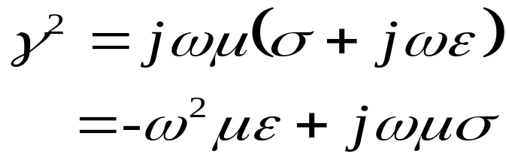




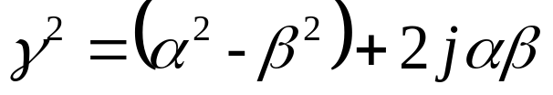
From vector identity :
(1)
(2)
Equating (4) and (5) for Re and Im parts :
Where :
(4)
Define :
(5)

Slide 11
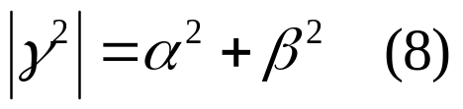
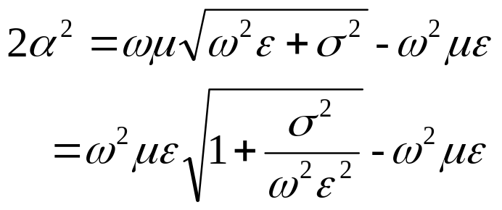
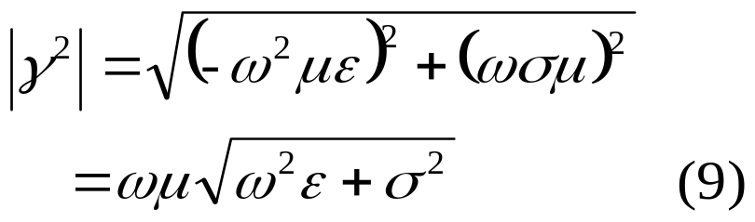
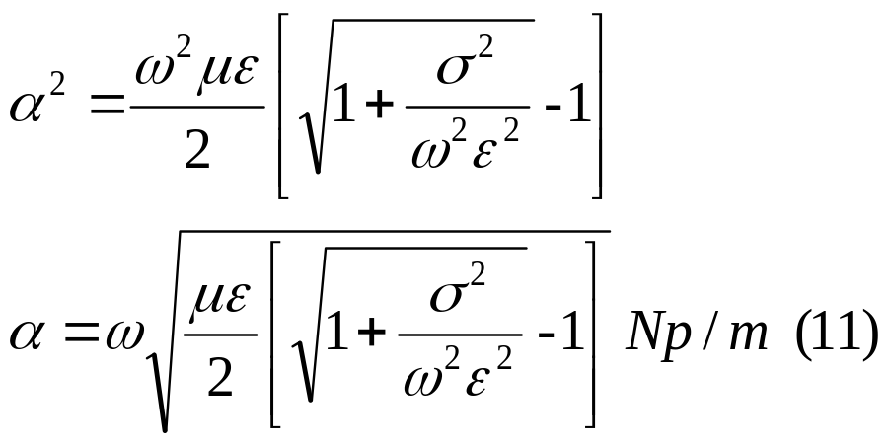
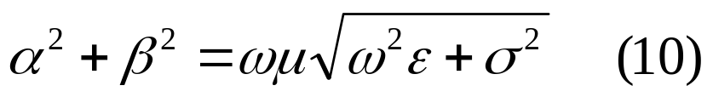
Magnitude for (5) ;
Add (10) and (6) :
Hence :
Magnitude for (4) ;
Equate (8) and (9) :
α is known as attenuation constant as a measure of the wave is attenuated while traveling in a medium.

Slide 12
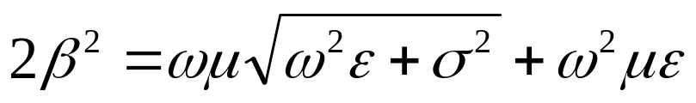
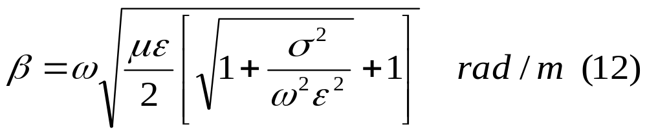
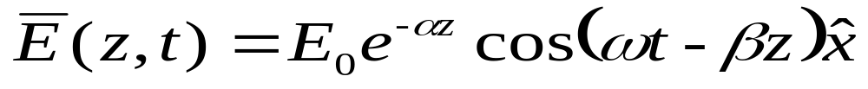
Substract (10) and (6) :
β is phase constant
If the electric field propagate in +z direction and has component x, the equation of the wave is given by :
(13)
And the magnetic field :
(14)

Slide 13
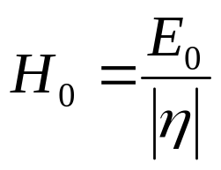


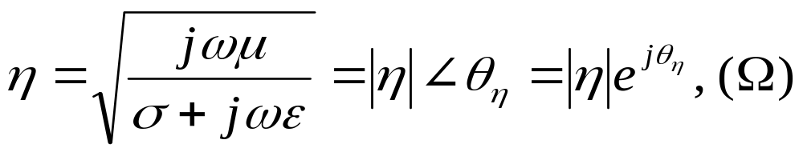
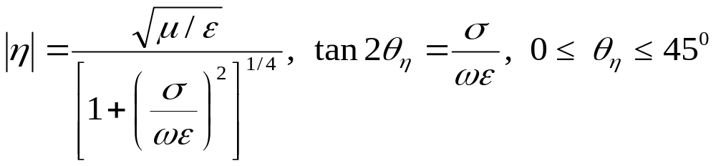


(14)
where ;
(15)
(15)
Intrinsic impedance :
(16)
where ;
(17)
Conclusions that can be made for the wave propagating in lossy dielectrics material :
(i) E and H fields amplitude will be attenuated by
(ii) E leading H by

Slide 14
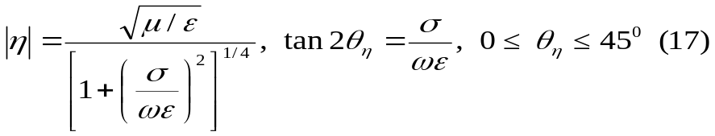

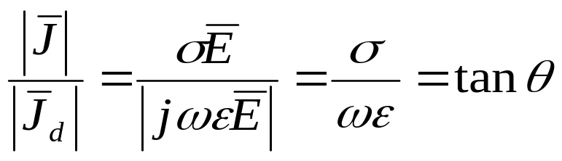

Wave velocity ;
Loss tangent ;
From (17) and (18)
(18)
Loss tangent values will determine types of media :
tan θ small (σ / ωε < 0.1) – good dielectric – low loss
tan θ large (σ /ωε > 10 ) - good conductor – high loss
Another factor that determined the characteristic of the media is operating frequency. A medium can be regarded as a good conductor at low frequency might be a good dielectric at higher frequency.

Slide 15
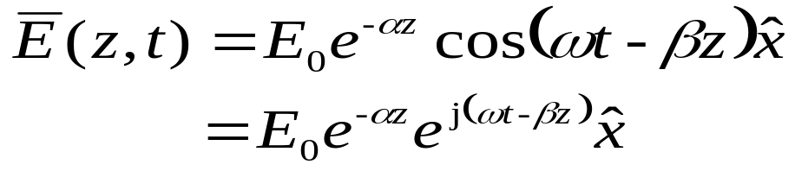
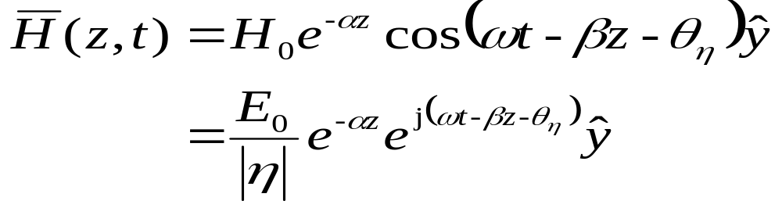



(14)
(15)
Graphical representation of E field in lossy dielectric
x
z
y

Slide 16

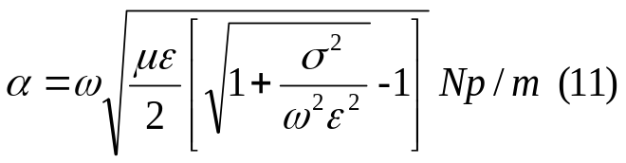
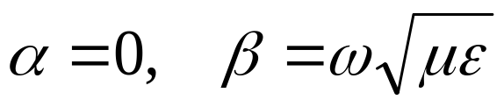
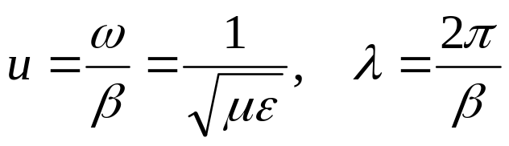
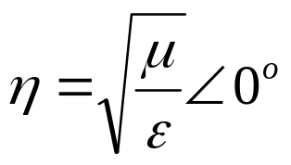
10.3 PLANE WAVE IN LOSSLESS (PERFECT) DIELECTRICS
Characteristics:
(19)
Substitute in (11) and (12) :
(20)
(21)
(22)
The zero angle means that E and H fields are in phase at each fixed location.

Slide 17

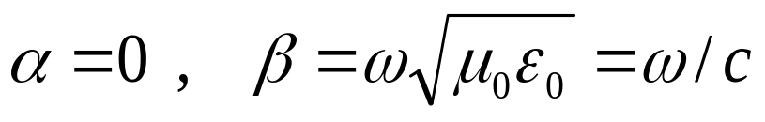
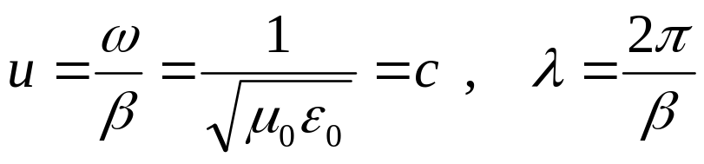
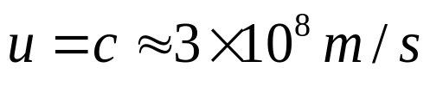

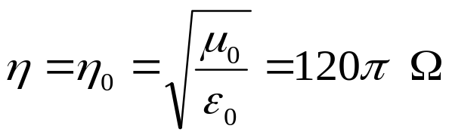
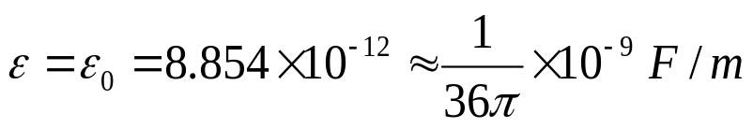
10.4 PLANE WAVE IN FREE SPACE
Free space is nothing more than the perfect dielectric media :
Characteristics:
(23)
(20)
Substitute in (20) and (21) :
(21)
(24)
(22)
(25)
where
(26)

Slide 18
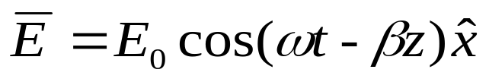


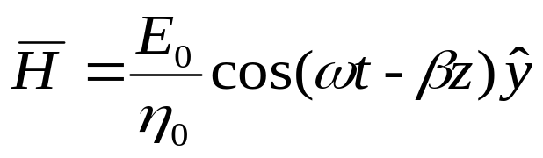

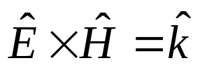
The field equations for E and H obtained :
(27)
(14)
(15)
(28)
E and H fields and the direction of propagation :
x
Generally :
E_{x}⁺ kos(-βz)
z
(at t = 0)
H_{y}⁺ kos(-βz)
y

Slide 19
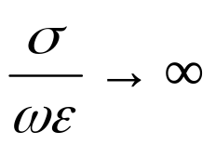


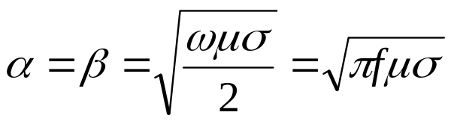



10.5 PLANE WAVE IN CONDUCTORS
In conductors : or
With the characteristics :
(29)
Substitute in (11 and (12) :
(30)
E leads H by 45⁰
(31)
The field equations for E and H obtained :
(32)
(33)

Slide 20






It is seen that in conductors and waves are attenuated by
From the diagram is referred to as the skin depth. It refers to the amplitude of the wave propagate to a conducting media is reduced to e⁻¹ or 37% from its initial value.
In a distance :
It can be seen that at higher frequencies is decreasing.
(34)
x
E₀
0.368E₀
z

Slide 21






Ex.10.1 : A lossy dielectric has an intrinsic impedance of at the particular frequency. If at that particular frequency a plane wave that propagate in a medium has a magnetic field given by :
Find and .
Solution :
From intrinsic impedance, the magnitude of E field :
It is seen that E field leads H field :
Hence :

Slide 22





To find :
; and we know
Hence:

Slide 23







10.6 POWER AND THE POYNTING VECTOR
(35)
(36)
Dot product (36) with :
(37)
From vector identity:
(38)
Change in (37) and use (38) , equation (37) becomes :
(39)

Slide 24




(39)
(35)
And from (35):
(40)
Therefore (39) becomes:
(41)
where:
Integration (41) throughout volume v :
(42)

Slide 25


(42)
Using divergence theorem to (42):
Total energy flow leaving the volume
The decrease of the energy densities of energy stored in the electric and magnetic fields
Dissipated ohmic power
Equation (43) shows Poynting Theorem and can be written as :

Slide 26




Poynting theorem states that the total power flow leaving the volume is equal to the decrease of the energy densities of energy stored in the electric and magnetic fields and the dissipated ohmic power.
The theorem can be explained as shown in the diagram below :
Output power
Ohmic losses
Stored electric field
Stored magnetic field
Input power

Slide 27



Given for lossless dielectric, the electric and magnetic fields are :
The Poynting vector becomes:

Slide 28


To find average power density :
Integrate Poynting vector and divide with interval T = 1/f :
Average power through area S :

Slide 29




Given for lossy dielectric, the electric and magnetic fields are :
The Poynting vector becomes:
Average power :

Slide 30



Ex.10.2: A uniform plane wave propagate in a lossless dielectric in the +z direction. The electric field is given by :
The average power density measured was . Find:
Dielectric constant of the material if
Wave frequency
Magnetic field equation
Solution:
(i) Average power :

Slide 31


For lossless dielectric :
(ii) Wave frequency :

Slide 32

(iii) Magnetic field equation :

